Slide 1

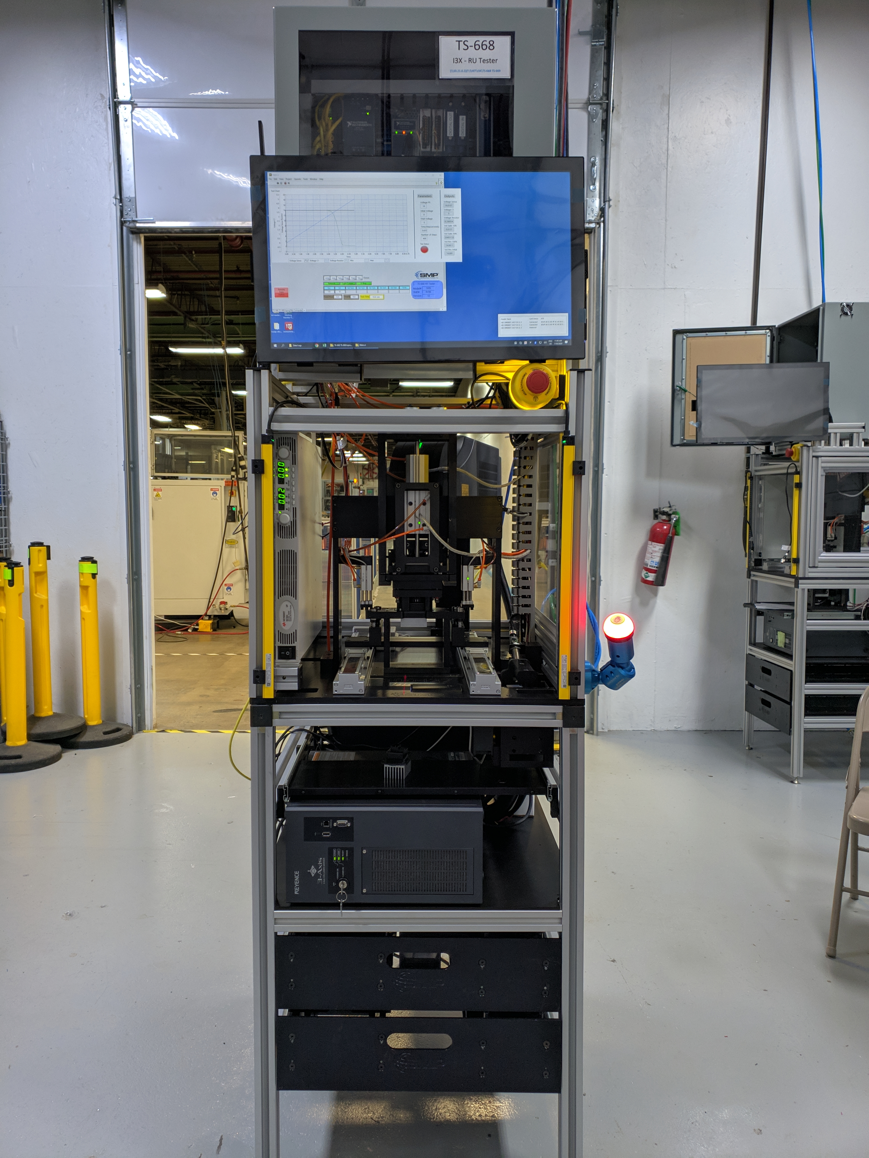
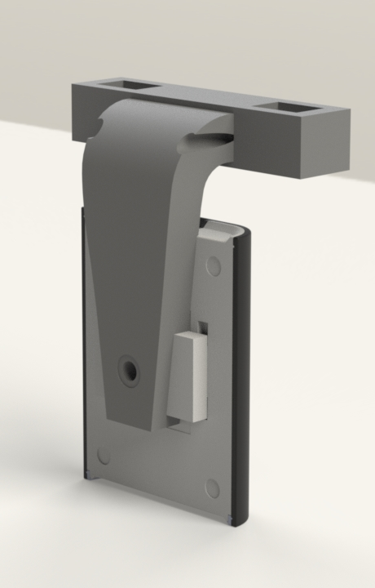
RU Blower Motor Switch EOL tester
By: Luis Chachayma – Designed whole tester controls, wiring diagram and LabVIEW programming
Designed and 3D printed a RFID/NFC reader holder to accelerate the project
PROJECT OVERVIEW
EOL (end of line) testers are used for final verifications of the functionality of auto parts. The tester must be easy to use and it must be precise to guarantee the part is going to be tested correctly.
The project was to develop an EOL tester for a Blower Motor Switch, with the following requirements:
The tester must be able to test different models and use a resistor as a load.
Conditions of normal operation in the vehicle must be followed, voltages and currents.
Intuitive and easy to operate HMI to operate the tester and test different models.
Data logs must be saved of all parts tested and a code should relate the data logs with the code engraved on the part tested.
Test must pass a Gage R&R.
LabVIEW programming and debugging.
Analog inputs and outputs calibration verification with quality lab.
Safety sign Off.
Gage R&R.
Operator capacitation.
IMPLEMENTATION STEPS
The process team gets together to select the mechanical and electronic components.
The mechanical and the test engineer coordinate the CAD design requirements.
The wiring diagram is done by the test engineer and the fixture design by the mechanical engineer
The fixtures are manufactured by Tool & Die.
Electronic and mechanical components are put together.
Electronic equipment is configured: Vision System, Laser Marker, Pneumatic Valves controllers, Temperature sensors, NI DAQ, Linear actuators.
Tester implemented
CAD drawing RFID/NFC reader
Notes:
1

